Slide 1

MARCH 2019

Slide 2

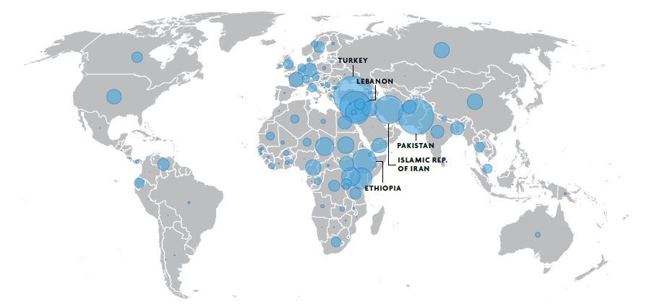
REFUGEES WORLDWIDE
25.4 MILLION
Current number of refugees worldwide
85%
Percentage of refugees hosted by developing countries
Data Source: UNHCR Statistical Yearbook, October 2018

Slide 3
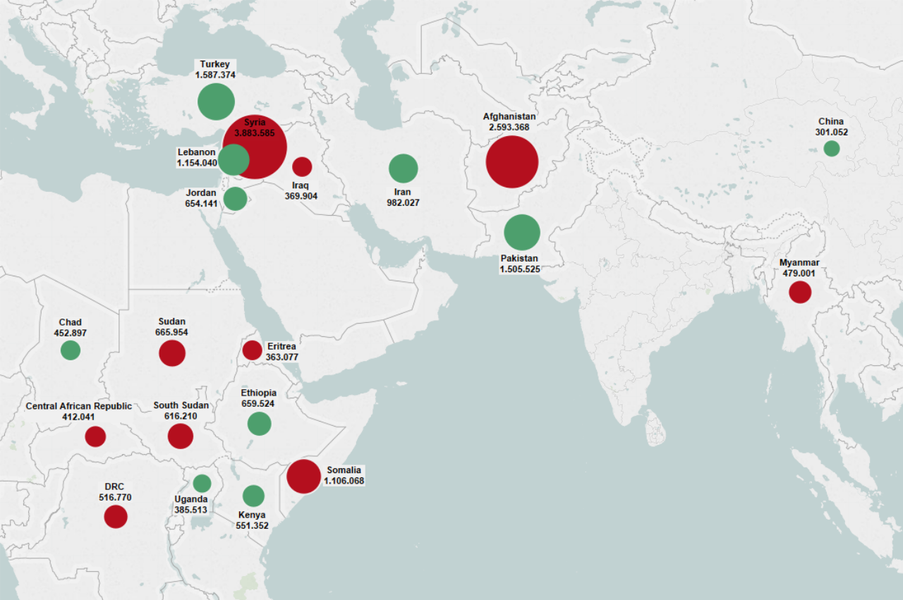
COUNTRIES OF ORIGIN
Countries of origin
Countries of asylum

Slide 4
REFUGEES IN EUROPE
5.2 MILLION
Number of refugees in Europe
0.46%
NETHERLANDS UK ITALY SWEDEN FRANCE GERMANY
103,860 121,837 167,335 240,962 337,177 970,365
of the EU population
There are about 167,335 refugees in Italy. In comparison, Germany hosts about 970,365 refugees, France about 337,177 and Sweden about 240,962. (UNHCR Population Statistics, 2018)
Number of refugees per 1,000 inhabitants (UNHCR, Global Trends 2016)

Slide 5
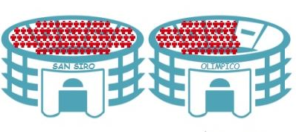
REFUGEES IN ITALY
167,335
=
0.27%
Refugees in Italy
Italian population
If all 167,335 refugees in Italy gathered in the same place…
…they would barely fill Italy’s two principal football stadiums, each holding about 80,000 people
UNHCR Population Statistics, 2018

Slide 6
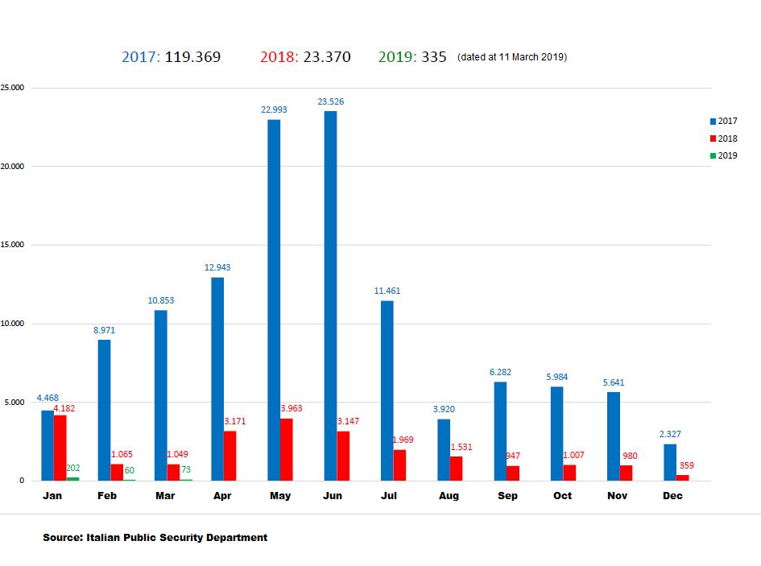
ARRIVALS TO ITALY
ARRIVALS TO ITALY

Slide 7
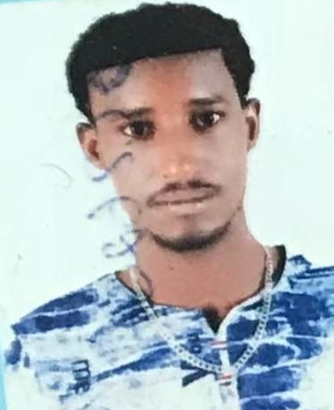
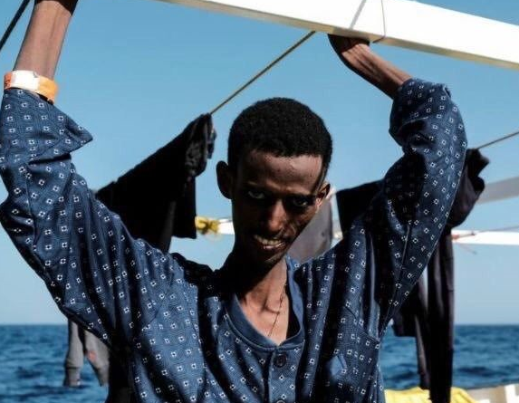
ITALIAN EXTERNALISATION POLICIES
ITALY – LIBYA MEMORANDUM OF UNDERSTANDING (February 2017) :
Italy committed to pay €220 million to the Libyan coastal guard and provide training to help them catch the vessels—primarily rubber dinghies. In exchange, the Libyan coast guard committed to send the boats back to Libya and to put people into detention centres.
Human Rights Watch: “Migrants and asylum seekers detained in Libya, including children, are trapped in a nightmare, and what EU governments are doing perpetuates detention instead of getting people out of these abusive conditions”
EU migration commissioner, Dimitri Avramopoulos: “We are all conscious of the appalling and degrading conditions in which some migrants are held in Libya.”

Slide 8
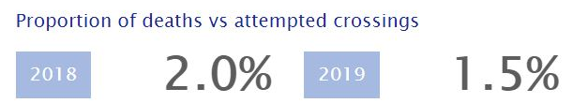
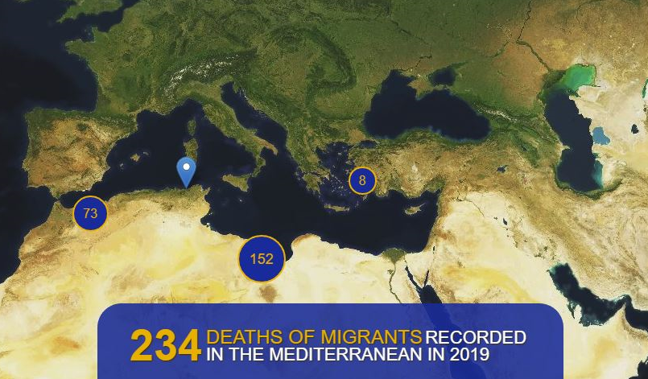
DEATHS AT SEA
The number of deaths at sea in the Mediterranean from 1990 to 2018
33.000

Slide 9
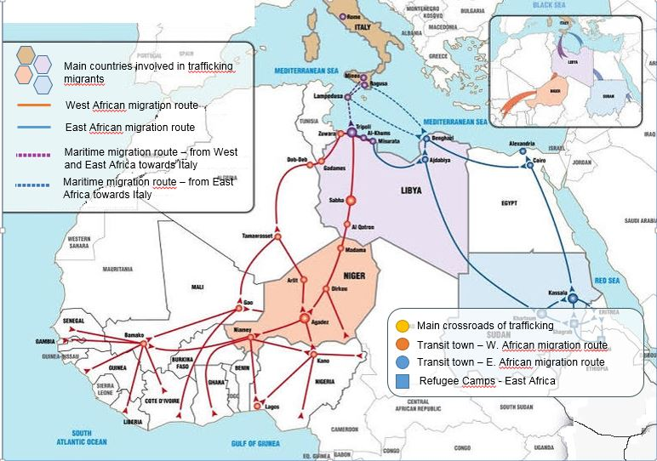
GETTING TO EUROPE
BY SEA
Migration routes to Italy across North Africa
Maritime route is used
7 times out of 10

Slide 10
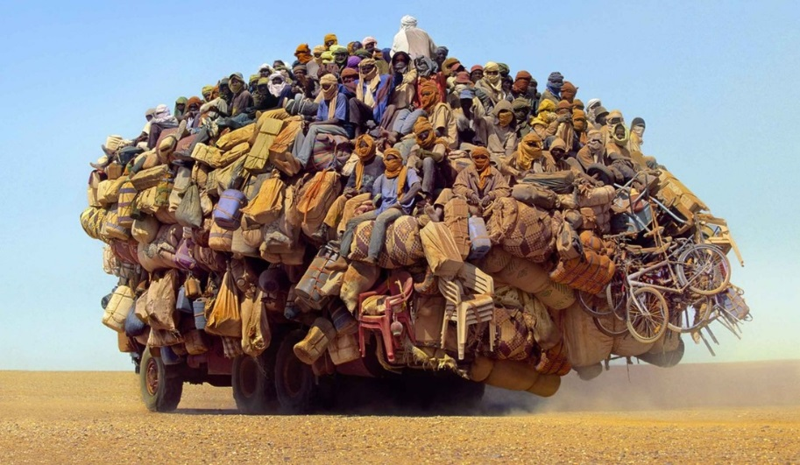
THROUGH THE DESERT
“I left Eritrea four years ago; I stayed for three years in the Mai Aini refugee camp in Ethiopia. I lived for more than a year in Libya and I attempted the crossing twice, paying about $1,0000. After the first failed attempt, I was captured by the Libyan authorities who locked me up for a month. Of the whole journey, the riskiest stretch was that on the border between Sudan and Libya: the desert, the lack of water and food, the car journey with all the migrants gathered on single vehicle travelling at high speed. Some people fell off the vehicle and were left behind. It took me four days to cross the border between Sudan and Libya.”
20 year old Eritrean youth
“I spent three months in Libya in a north-eastern coastal town, then in Benghazi and finally in Tripoli. I was raped many times by pro- and anti-government soldiers and released only on payment of a ransom. I spent twenty days in a detention centre with another 700 people: they gave us food once a day and it was not possible to leave the building.
The most dangerous stretch of the journey was the crossing between Sudan and Libya. In Libya, in the desert, I witnessed the murder of more than twenty people by Libyan soldiers who shot them on sight. The Egyptian border is also very dangerous because of the presence of numerous soldiers monitoring entry of people fleeing Libya. Anyone stopped was transferred to a detention centre indefinitely and able to leave only on payment of $300 to return to Ethiopia.”
28 year old Eritrean man

Slide 11
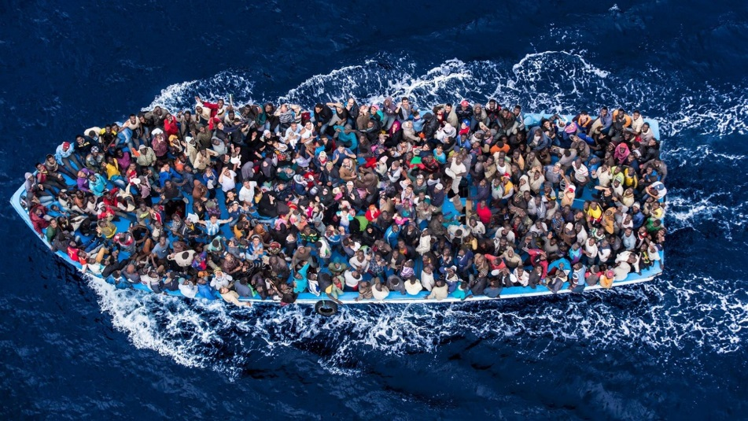


BY SEA
“We spent four days in the Mediterranean sea before we got to Italy. Many people have died, some people fainted, we ran out of water and we ran out of food. Also we ran out of petrol. We ran out of everything, we were hopeless in the sea, the wind was just taking us from one point to the other”
Average journey price:
€ 2.500
€ 200
€ 100
€ 300
€ 180

Slide 12


3 OCTOBER 2013: A WATERSHED
368 migrants died in a single shipwreck near the island of Lampedusa
Numbers from north Africa, sub-Saharan Africa and the middle east crossing to Italy cannot be ignored

Slide 13
MEDITERRANEAN HOPE PROJECT
Mediterranean Hope (MH) is a project of the Federation of Protestant Churches in Italy (FCEI)
funded by the the “8 x 1000” system of the Waldensian and Methodist Churches and from some Protestant Churches abroad.
LAMPEDUSA
The Observatory on Migration, as well as producing information about and analysis of Mediterranean migration, is committed to welcoming those who arrive on the island.
SCICLI
The Casa delle Culture is situated a few kilometres from the port of Pozzallo, in Sicily. It is a place of welcome for migrants who are unaccompanied minors, single mothers and particularly vulnerable. It is also a space for integration and cross-cultural dialogue.
EUROPE
The Relocation Desk, based in Rome, is a service aimed at accompanying migrants transiting through the Casa delle Culture or other reception centres linked with Mediterranean Hope Programme to other parts of Europe.
FROM LEBANON, MOROCCO AND ETHIOPIA TOWARDS ITALY
Humanitarian corridors provide a visa with limited territorial validity for those seeking international protection for those who are particularly vulnerable so that they can reach Italy safely and without having to risk their lives at sea.

Slide 14
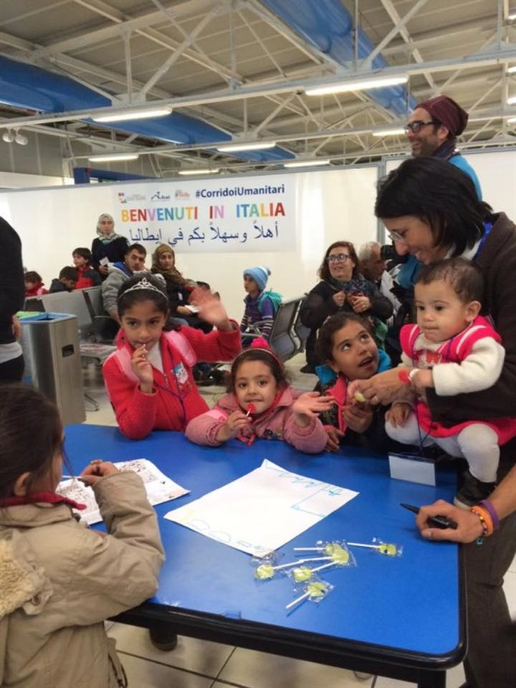
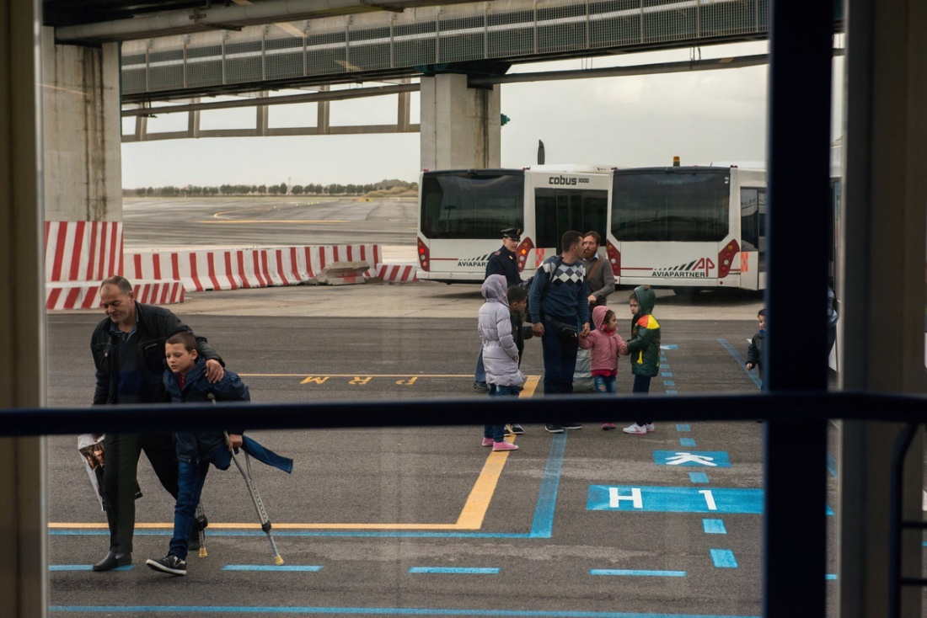
HUMANITARIAN CORRIDORS
ACESSING PROTECTION IN
SAFETY AND DIGNITY

Slide 15

MH HUMANITARIAN CORRIDORS
Humanitarian Corridors result from a Memorandum of Understanding signed by:
Italian Ministry of Foreign Affairs and International Co-operation – General Directorate for Italians Abroad and Migration Policy
Italian Ministry of the Interior – Department for Civil Liberties and Immigration
Federation of Protestant Churches in Italy
Comunità di Sant’Egidio
Tavola Valdese
Notes:
15

Slide 16
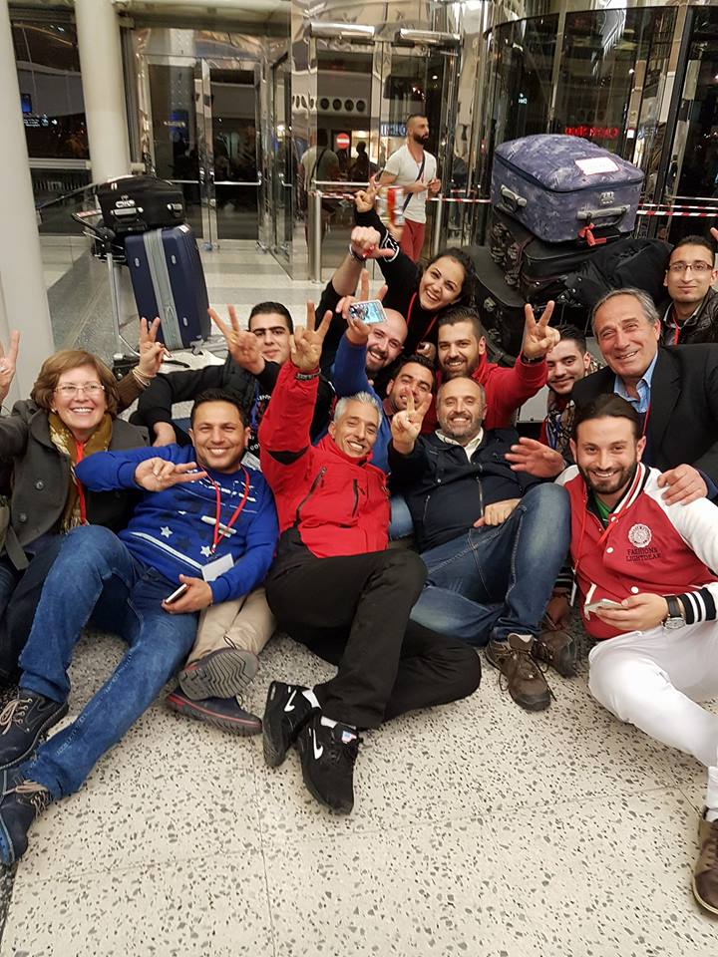
EVOLUTION
15 December 2015
Signature of a Memorandum of Understanding (MoU) enabling 1000 asylum seekers to come to Italy over a 2 year period (2016 – 2017), via a safe and legal channel.
MoU provides for humanitarian visas to be granted from Lebanon, Morocco and Ethiopia.
December 2017
MoU renewed for a further two years 82018 – 2019) for another 1000 visas.

Slide 17
COMPLEMENTARY TO AND DISTINCT FROM EU RESETTLEMENT
RESETTLEMENT | HUMANITARIAN CORRIDORS
Refugee status granted upon arrival within the receiving country | Application for international protection required upon arrival in the receiving country and processed in same way as for every asylum seeker
Beneficiaries must fall under UNHCR’s mandate | Beneficiaries need not fall under UNHCR’s mandate
Beneficiaries identified in accordance with 1951 Convention criteria or broader refugee definition under UNHCR’s mandate | Beneficiaries identified on basis of vulnerability criteria and in-depth assessment of individual, personal and situational circumstances
Funded by EU | Funded by “8 x 1000” system of the Waldensian and Methodist churches
Beneficiaries’ first reception borne by national reception system | Beneficiaries’ first reception borne by the participating organisations
EU Resettlement Programme: one of the key actions in the European Agenda on Migration of 13 May 2015 | Based on Article 25 of EC Regulation n. 810/2009 of 13 July 2009 (Community Code on Visas) which permits Member States to issue visas with limited territorial validity (1) for humanitarian reasons (2) in the national interest or (3) as a result of international obligations

Slide 18
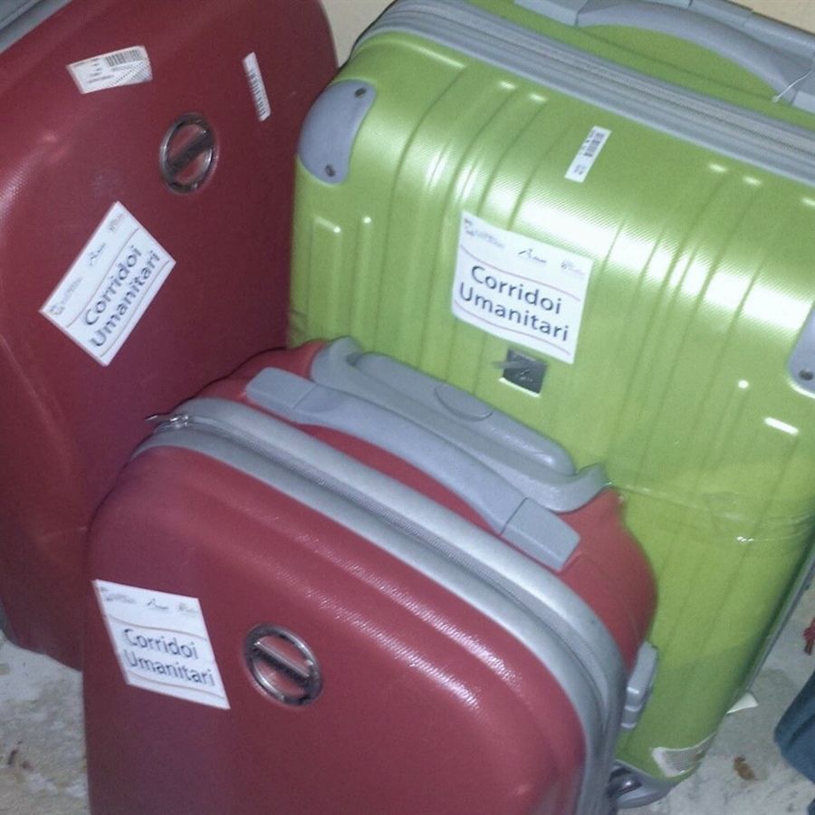
PRINICIPAL OBJECTIVES
To enable people «in a vulnerable state» to enter Italy safely and to make a request for international protection;
To avoid dangerous sea crossings, which have already caused a high number of deaths;
To prevent those fleeing being trafficked by unscrupulous individuals;
To provide a legal means of entering Italian territory by granting humanitarian visas on completion of a series of pre-departure checks by the Italian authorities.

Slide 19
COUNTRIES OF ORIGIN
Country | Syria | Palestine (Syria) | Iraq | Palestine | Lebanon | Palestine (Lebanon) | Yemen | Jordan | Morocco
Guests | 1235 | 32 | 19 | 11 | 10 | 2 | 2 | 1 | 1
So far 1336 vulnerable migrants have entered Italy safely and legally through our humanitarian corridors. Of these, 612 have been looked after by the Federation of Protestant Churches in Italy, FCEI-CSD.
74% OF BENEFICIARIES HAVE BEEN GRANTED A FORM OF INTERNATIONAL PROTECTION

Slide 20
IDENTIFYING BENEFICIARIES & GRANTING VISAS
Proposing organisations put forward lists of potential beneficiaries compiled via direct contacts in countries covered by the project or from suggestions made by local actors (NGOs and other associations, international organisations, churches and ecumenical organisations etc.). Each proposal is reviewed at a senior level by the organisations concerned and then by the Italian authoritiies;
The lists of potential beneficiaries are transmitted to the Italian consular authorities in the relevant countries for review by the Ministry of the Interior;
Once Italian Ministry of the Interior has given the green light, the lists are again checked by the authorities in the relevant countries;
Italian consulates in the relevant countries grant visas with limited territorial validity to enable entry onto Italian territory.

Slide 21







SELECTION CRITERIA
Families with children
Single mothers
Elderly people
Unaccompanied minors
Disabled people
Urgent medical cases
Victims of trafficking, torture and violence

Slide 22

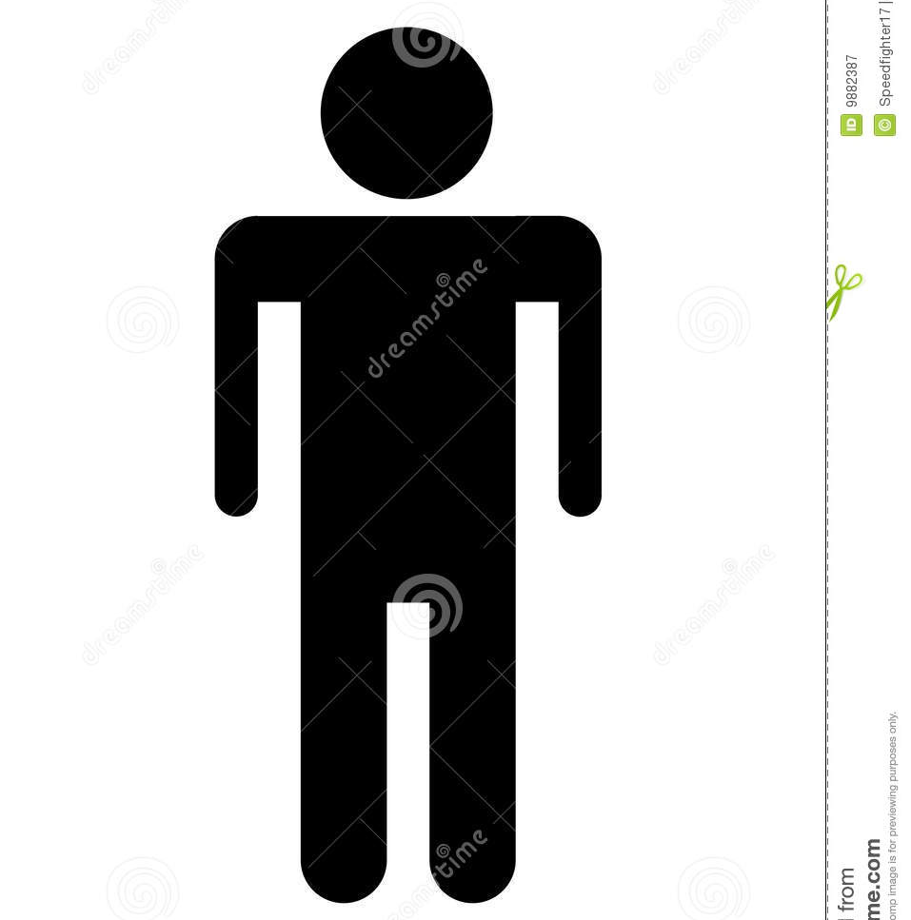

RECEPTION IN ITALY
612 participants have been welcomed into reception facilities belonging to the Federation of Protestant Churches in Italy ( FCEI)
They have been received across 94 communes, into 18 out of the 20 Italian regions
245 have voluntarily left the programme for various reasons (achieving independence, family reunification outside Italy, project exit)
Our own facilities are managed by the Diaconate Synodal Commission (CSD) but participants are received by different types of host:
Host | Faith organisation | Church | Secular organisation | Next-of-kin in Italy | Private individuals
Guests | 54% | 21% | 14% | 3% | 8%

Slide 23

REGIONAL BREAKDOWN
FRIULI VENEZIA GIULIA 24
Gorizia; Imponzo (UD); Maniago (PN); Lestans-Sequals (PN)
LIGURIA 24
Genoa
PIEDMONT 273
Turin; Lucerne S. Giovanni (TO); Leini (TO); Rivalta di Torino (TO); Novara; Marene (CN); Occhieppo Inferiore (BI); Pinasca (TO); Fossano (CN); Ivrea (TO); Vercelli
VENETO 88
Padua; Venice; Adria (RO); Thiene (VI); Pescantina (VE); Brugine (PD); Cornuda (TV); Treviso
LOMBARDY 183
Melegnano (MI); Milan; Bergamo; Brescia; Saronno (VA);
Bancole (MN); Mantova; Pegognaga (MN); Albizzate (VA); Como (CO);
Gonzaga (MN); Felonica (MN); Rossini (LC); Valbondione (BG); Binasco (MI); Rivarolo del Re (CR); Bosisio Parini (LC)
TRENTINO ALTO ADIGE 49
Trento; Caderzone (TN)

Slide 24


REGIONAL BREAKDOWN
EMILIA ROMAGNA 53
Reggio Emilia; Novellara (RE); Parma; San Savino (RN); Bagnolo (RE); Bologna; Bomporto (MO); Porretta Terme (BO); Ferrara; Anzola dell'Emilia (BO)
LE MARCHE 47
Fano (PU); Pesaro; Ancona
UMBRIA 34
Perugia; Terni; Gubbio (PG)
LAZIO 261
Rome; Aprilia (LT); Pomezia (RM); Monteporzio Catone (RM); Lanuvio (RM); Morena (RM); Frosinone
TUSCANY 73
Reggello (FI); Florence; Pisa; Asciano (SI); Rosignano Marittimo (LI); Lucca; Arezzo; Cetona (SI); Montalcino (SI); Buti (PI)
SAN MARINO 5

Slide 25
REGIONAL BREAKDOWN
CALABRIA 57
Gioiosa Ionica (RC); Reggio Calabria; Cosenza; Badessa di Mussano (CS)
CAMPANIA 42
Naples; Ischia (NA); Meta (NA); Salerno; Portici (NA)
BASILICATA 20
Potenza; Matera
SARDINIA 20
La Maddalena (SS); Badesi (SS)
PUGLIA 11
Bari; Foggia
SICILY 62
Palermo; Scicli; Polizzi Generosa (PA); Modica (RG)

Slide 26
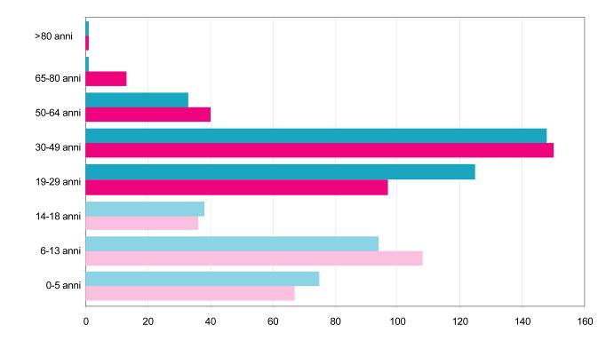
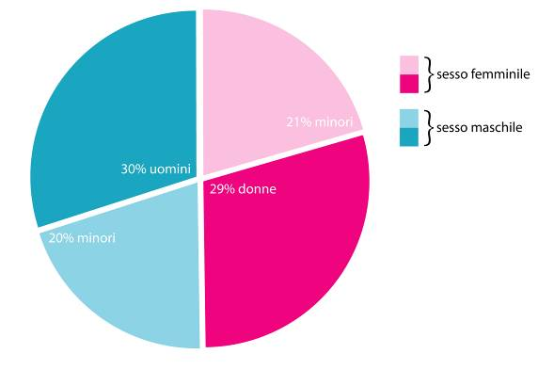
DEMOGRAPHIC DISTRIBUTION BY GENDER AND AGE
AGE BREAKDOWN
MALE 50.43% FEMALE 49.57%

Slide 27

RELIGIOUS AFFILIATION
48% of refugees brought to Italy have been Muslim, predominantly Sunni.
36% are Christian, in differing proportions from all of the following denominations:
Roman Catholic
Greek Orthodox
Greek Catholic
Armenian Apostolic
Protestant
Assyrian
Syriac Orthodox

Slide 28











TOOLS FOR INTEGRATION
On arrival in Italy, participants are supported on the path to integration as follows:
Physical accommodation within flats and small accommodation centres;
Social cross-cultural mediation;
Healthcare and psychological support;
Literacy and Italian language courses for adults
School placement for minors
Legal information and support
Needs’ assesment
Public Service orientation
Job orientation
Academic and Vocational training opportunities
Apprenticeship opportunities

Slide 29
EDUCATION AND TRAINING
Priority is given to facilitating integration via Italian language tuition.
Ongoing support in relation to attendance at school for minors is an essential part of complex family assistance.
The rate of school attendance is around 90%.

Slide 30
TRAINING AND EMPLOYMENT
Currently, all of the adults in FCEI-CSD accommodation attend weekly Italian tuition for at least 18 hours per week.
All minors of school age have been placed within the national education system.
Over the first year of the programme, our guests were able to secure employment contracts (47%) and vocational apprenticeships (13%), attend language and professional training courses (37%) or enrol at university (3%).

Slide 31
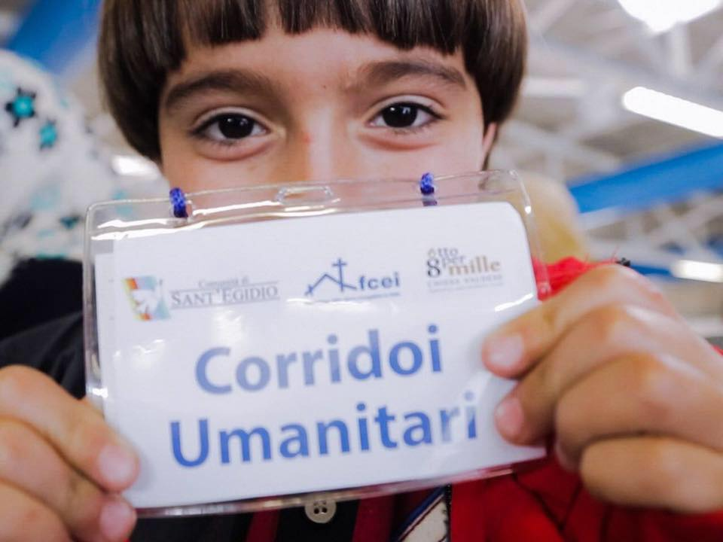
Info & Contacts:
Federation of Protestant Churches in Italy
Mediterranean Hope
Refugee and Migrant Programme
www.mediterraneanhope.org
mh@fcei.it
Tel. +39. 06.48905101

